Slide 1
Team Ink3D Detail Design Specification Review
Daniel Lain
Tim Edmonson
Shawn Simonson
Jesse Bowles

Slide 2
Outline
Architecture Overview
Module Overview
Critical Data Object Requirements
Detail Module Descriptions
Requirements Traceability
Acceptance Plan

Slide 3
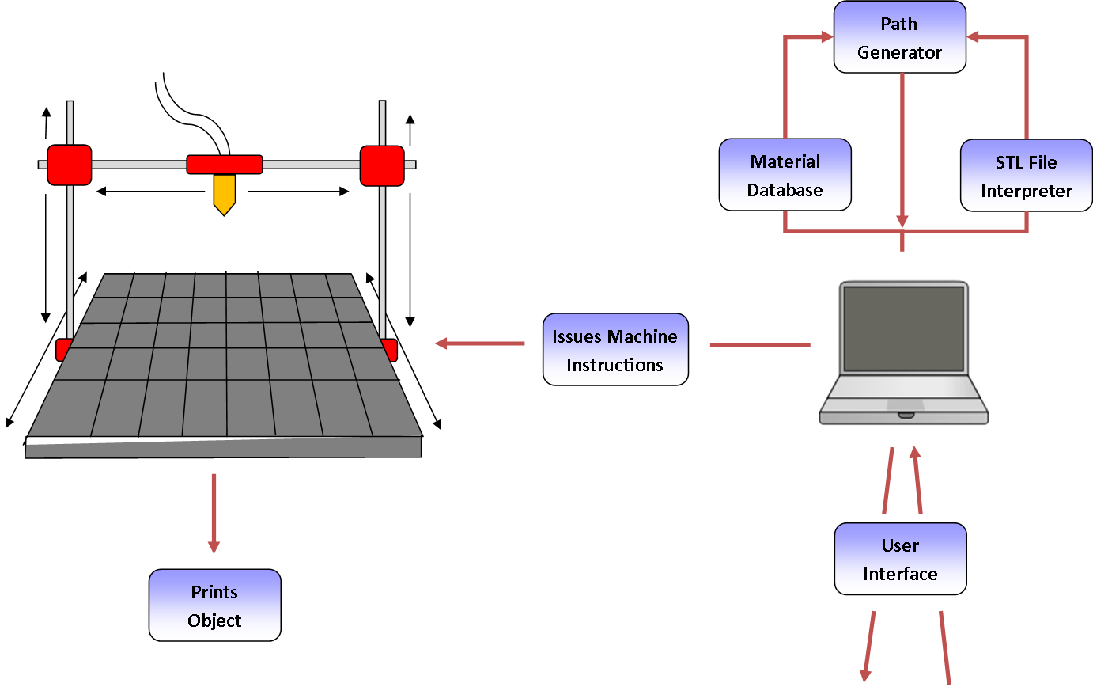
Architecture Overview
Configurability
Modularity
Expandability
Portability
Multiple Materials

Slide 4
Architecture Design
Seven Layers
Layer Independence
Interface Based
Master Configuration Object

Slide 5
Module Decomposition
High Cohesion
Low Coupling
Master Configuration Object

Slide 6
Module Data Flows
Layer | Data Flow ID | Data
Outside Inputs | OI1 | Object file of the STL file to be printed
 | OI2 | Printer configuration data entry values
 | OI3 | Material configuration data entry values
 | OI4 | Print configuration data entry values
 | OI5 | Print selections and button press
 | OI6 | Pause, resume, and stop button Presses
 | OI7 | Disk reads of XML and Directory structure
 | OI8 | Printer state information
 | OI9 | OS Driver information
 | OI10 | Extruder configuration data entry values
User Interface Layer | UI1 | Import file name
 | UI2 | Success state of import
 | UI3 | Loaded printer configuration
 | UI4 | Save printer configuration request
 | UI5 | Save material configuration request
 | UI6 | Loaded material configuration
 | UI7 | Loaded print configuration
 | UI8 | Save print configuration request
 | UI9 | Loaded configuration data
 | UI10 | Run print job
 | UI11 | Pause, resume, and stop button Presses
 | UI12 | Printer state information
 | UI13 | File Configuration object
 | UI14 | Printer configuration object
 | UI15 | Material configuration object
 | UI16 | Print Configuration object
 | UI17 | All requested configuration objects
 | UI18 | Object save/load requests
 | UI19 | Object save/load results
 | UI20 | XML File writes to disk
 | UI21 | Save print job configuration
 | UI22 | Print package object
 | UI23 | Print, Pause, Resume request
 | UI24 | Loaded Extruder Configuration Data
 | UI25 | Save Extruder Configuration Request
 | UI26 | Extruder Configuration Object
Preprocessing Layer | PR1 | Print package object
 | PR2 | Print package object
Processing Layer | PO1 | Print package object
Post-Processing Layer | PP1 | Print package object
 | PP2 | Print package object
Printer Control Layer | PL1 | G-Code
Communications Layer | CL1 | Serialized G-Codes
 | CL2 | Serialized printer state
 | CL3 | Command stream
Printer Feedback Layer | PF1 | Printer State Object
 | PF2 | Printer State Object
Many GUI Exchanges
Very Little In Processing

Slide 7
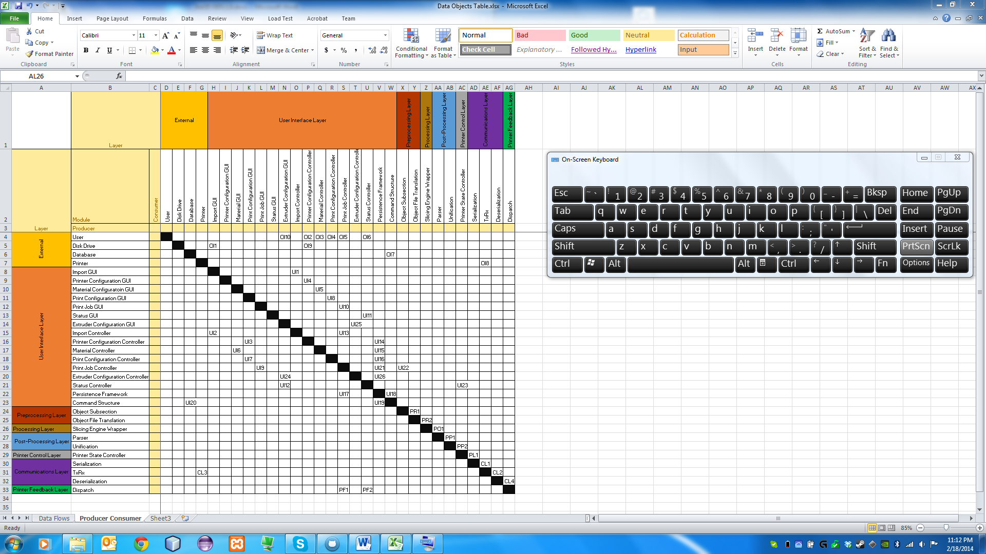
Producer Consumer Table
Many GUI Exchanges
Very Little In Processing

Slide 8
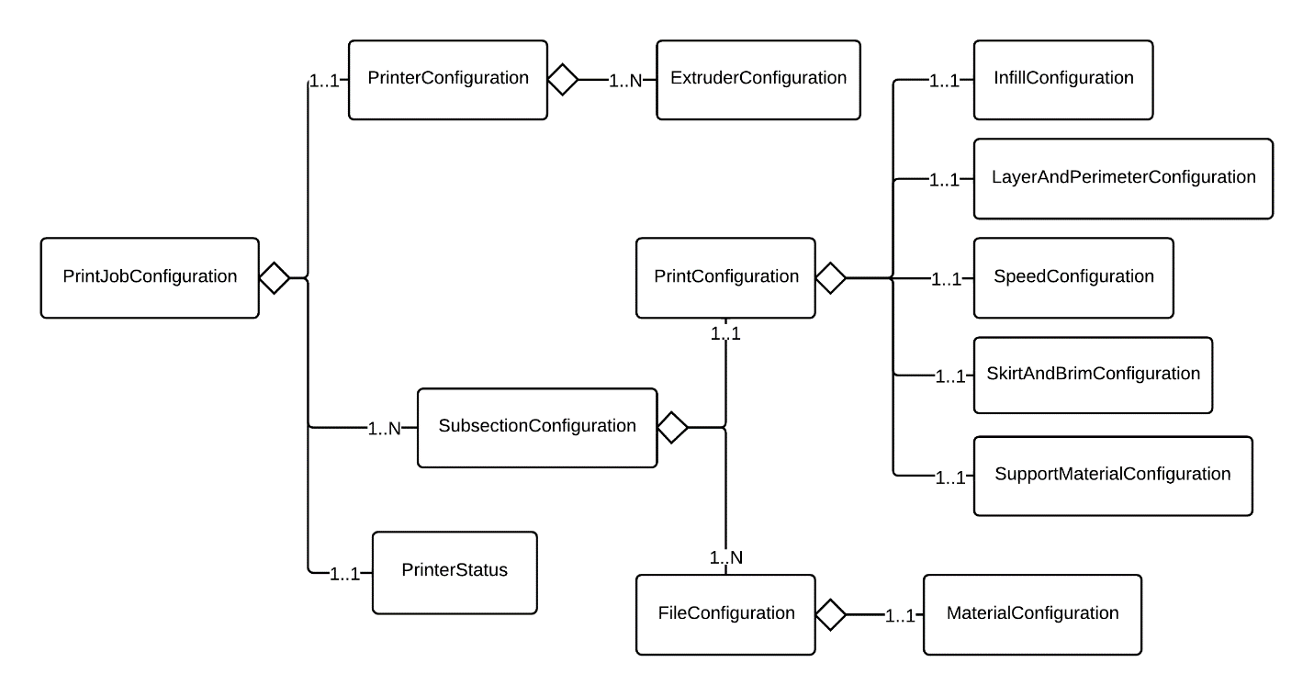
Print Job Configuration Object

Slide 9
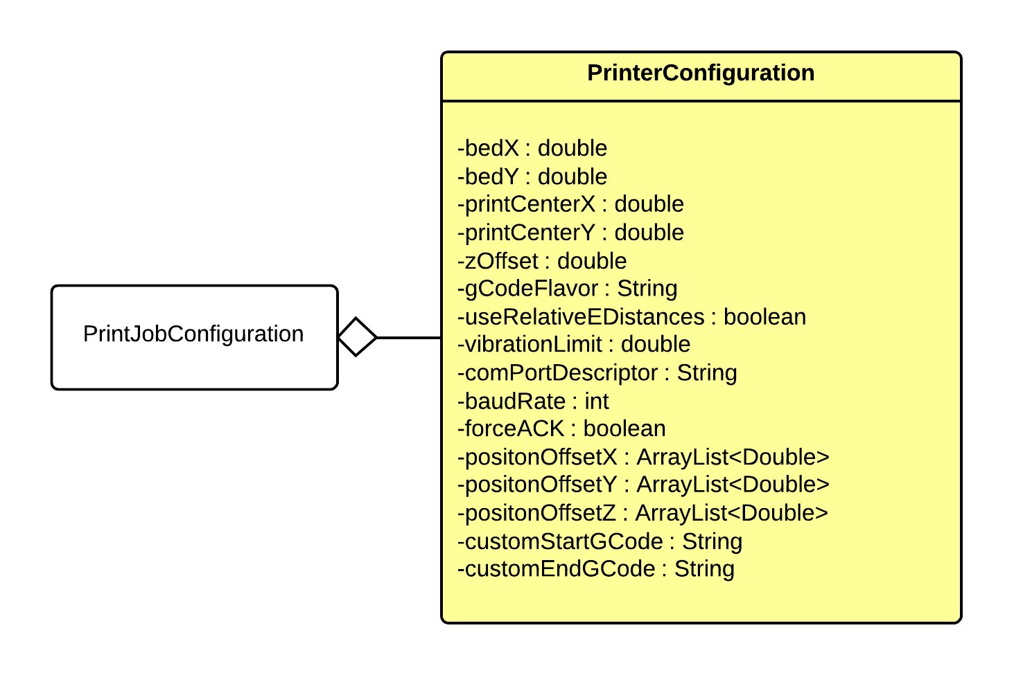
Printer Configuration Object
Name | Data Type | Description | Units | Boundaries
bedX | double | The max x of the bed. | mm | Greater than 0.
bedY | double | The max y of the bed. | mm | Greater than 0.
printCenterX | double | The x of the center of the print. | mm | 0 – bedX
printCenterY | double | The y of the center of the print. | mm | 0 – bedY
zOffset | double | The zOffset of the print bed surfaces. Used if the bed does not sit exactly at z = 0. | mm | Greater than or equal to 0.
gCodeFlavor | String | The G-Code flavor to output. | N/A | Within the set of available G-Code flavors.
useRelativeEDistances | boolean | When true, uses relative E values (required by some firmwares). | N/A | True or false
numExtruders | int | The number of extruders on the printer. | N/A | Greater than 0.
vibrationLimit | double | The limit of vibrations (in Hz) where movements will be slowed. If a move hits the specified vibration frequency, the extruder will slow. | Hz | Greater than or equal to 0.
comPortDescriptor | String | The descriptor for the com port the printer is connected to. Used to establish a connection to the printer. | N/A | N/A
baudRate | int | The baud rate for the printer. | Pulses per second | 0 - 250000
forceACK | boolean | States whether or not to use ACK as part of the protocol when communicating with the printer. | N/A | True or false
positionOffsetX | ArrayList<Double> | The x offset to apply to the extruder positions for the printer. These offsets are stored in an ArrayList where index 0 represents the x offset for position 0, etc. | mm | Double precision floating point boundaries.
positionOffsetY | ArrayList<Double> | The y offset to apply to the extruder positions for the printer. These offsets are stored in an ArrayList where index 0 represents the y offset for position 0, etc. | mm | Double precision floating point boundaries.
positionOffsetZ | ArrayList<Double> | The z offset to apply to the extruder positions for the printer. These offsets are stored in an ArrayList where index 0 represents the z offset for position 0, etc. | mm | Double precision floating point boundaries.
customStartGCode | String | The custom G-Code to run when the printer starts. | N/A | G-Codes that are understood by the printer.
customEndGCode | String | The custom G-Code to run when the printer shuts down. | N/A | G-Codes that are understood by the printer.

Slide 10
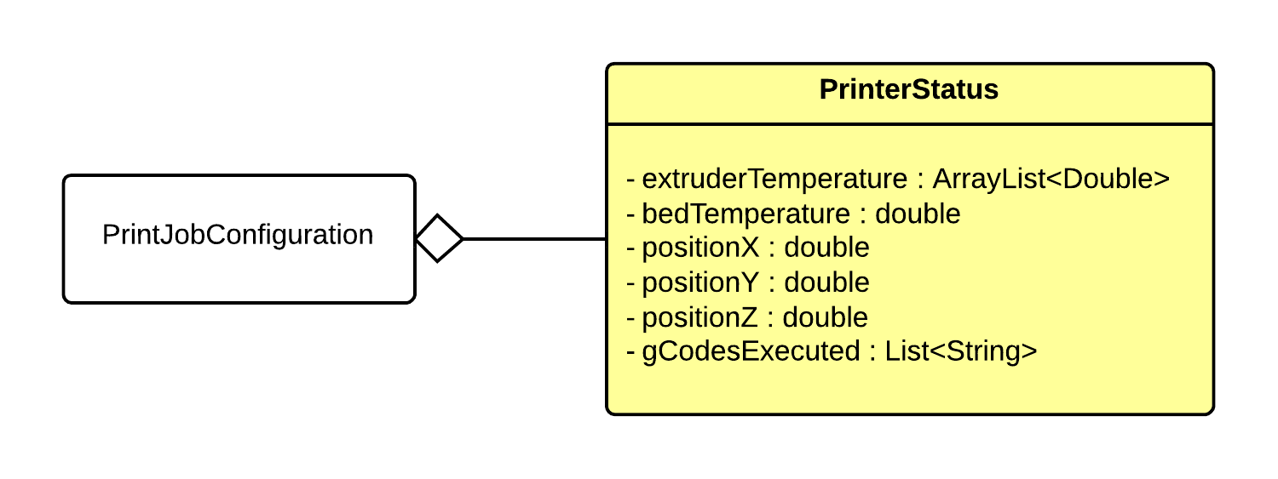
Printer Status Object
Name | Data Type | Description | Units | Boundaries
extruderTemperature | ArrayList<Double> | An ArrayList containing the current temperature of each extruder. | degrees C | Set by the material constraints of the materials in each extruder.
bedTemperature | double | The current temperature of the printer bed. | degrees C | Set by the printer configuration constraints.
positionX | double | The x position of the first extruder. | mm | Set by the printer configuration contraints.
positionY | double | The y position of the first extruder. | mm | Set by the printer configuration contraints.
positionZ | double | The z position of the first extruder. | mm | Set by the printer configuration contraints.
gCodesExectured | List <String> | The last 5 GCodes executed. | N/A | N/A

Slide 11
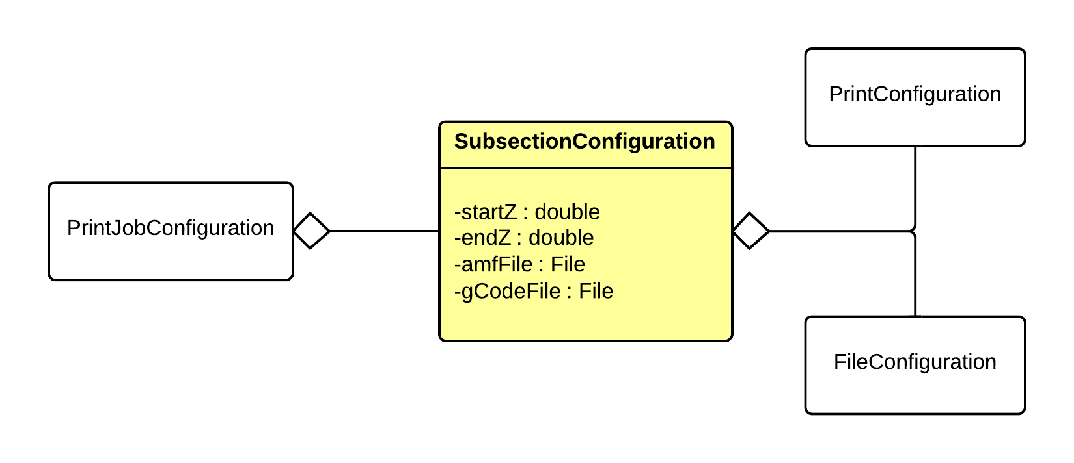
Subsection Configuration Object
Name | Data Type | Description | Units | Boundaries
bottomZ | double | The bottom of the subsection with relation to the entire object to be printed. | mm | Greater or equal to 0.
topZ | double | The top of the subsection with relation to the entire object to be printed. | mm | Greater than 0 and less than the total height of the object.
amfFile | File | The reference to the AMF file of the subsection. This is set during preprocessing. | N/A | N/A
gCodeFile | File | The reference to the gCode file of the subsection. This is set during processing. | N/A | N/A

Slide 12
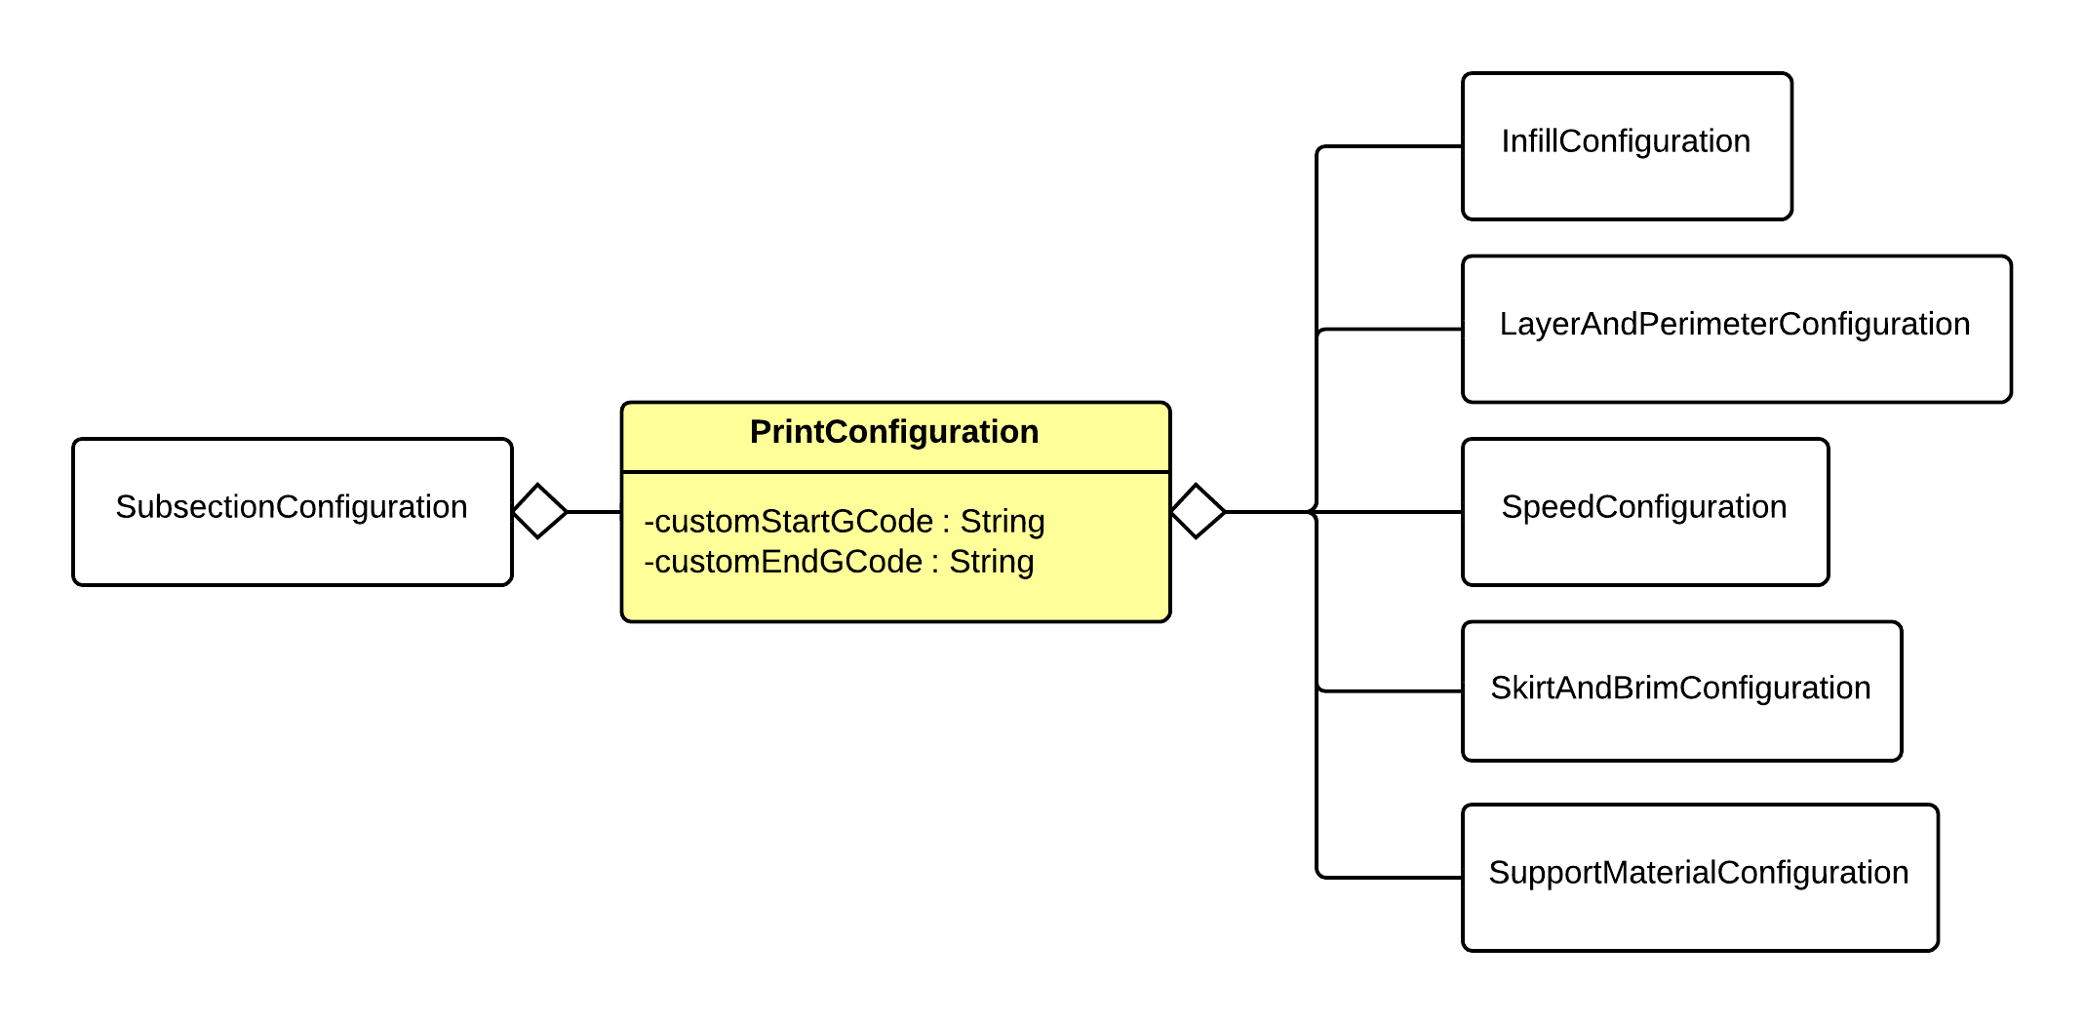
Print Configuration Object
Name | Data Type | Description | Units | Boundaries
customStartGCode | String | The custom G-Code to run when the print starts. | N/A | G-Codes that are understood by the printer.
customEndGCode | String | The custom G-Code to run when the print ends. | N/A | G-Codes that are understood by the printer.

Slide 13
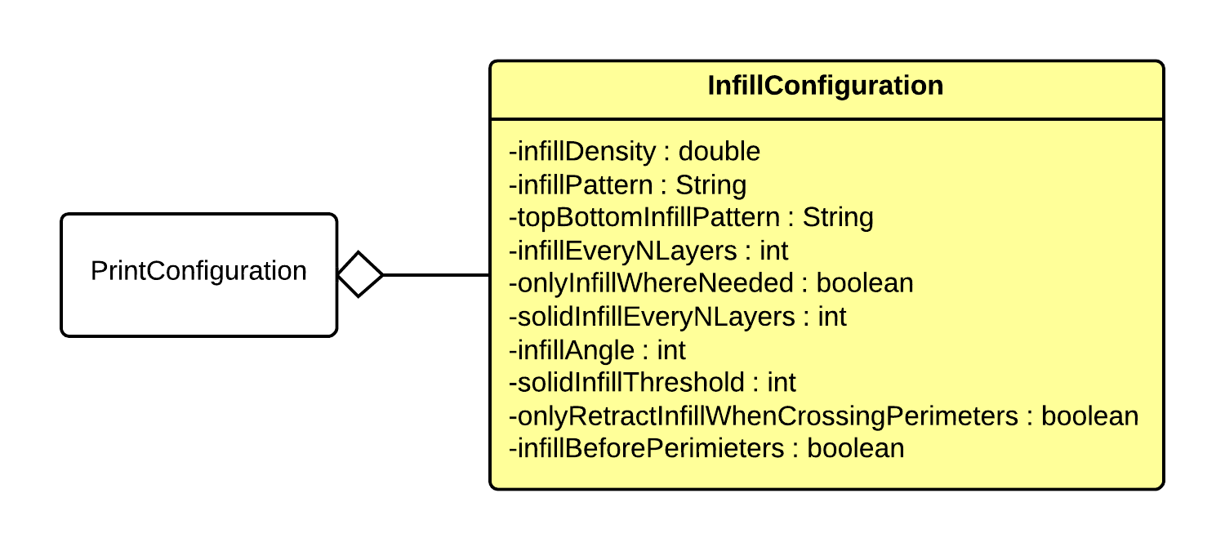
Infill Configuration Object
Name | Data Type | Description | Units | Boundaries
infillDensity | double | The density of infill from 0.0 - 1.0. 0.0 being no infill, 1.0 being a solid infill. | Ratio | 0.0 – 1.0
infillPattern | String | The pattern to use for internal infill. | N/A | Within set of available infill patterns.
topBottomInfillPattern | String | The pattern to use for the top and bottom layers' infill. | N/A | Within set of available infill patterns.
infillEveryNLayers | int | The ratio of layers to infill layers expresses as an integer >= 1. For example, infillEveryNLayers = 2 results in using infill every other layer, while infillEveryNLayers = 1 results in infill every layer. | N/A | Greater than or equal to 1.
onlyInfillWhereNeeded | boolean | When set to true, infill is treated as support material and only extruded where necessary. | N/A | True or false
solidInfillEveryNLayers | int | When set to a integer other than 0, a layer of solid infill with be extruded n layers, where the value of solidInfillEveryNLayers is n. | N/A | Greater than or equal to 0.
infillAngle | int | Default base angle for fill orientation in degrees from 0 to 359. This is the angle the infill will oriented in relation to the vertical perimeters. | degrees | 0 – 359
solidInfillThresholdArea | int | The threshold for area in square mm for which to force solid infill. | mm² | Greater or equal to 0.
onlyRetractInfillWhenCrossingPerimeters | boolean | When set to true, filament will not be retracted unless crossing a perimeter, resulting in some visible oozing throughout the infill. | N/A | True or false
infillBeforePerimeters | boolean | When set to true, infill for each layer will be extruded before the perimeters are extruded. | N/A | True or false

Slide 14
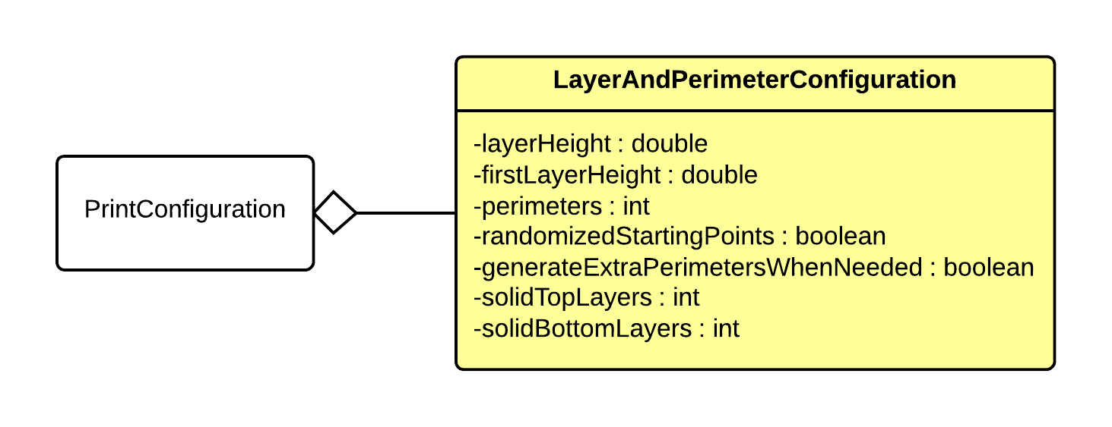
Layer & Perimeter Configuration Object
Name | Data Type | Description | Units | Boundaries
layerHeight | double | The height of each layer in mm. | mm | Greater than 0.
firstLayerHeight | double | The height of the first layer of the print in mm. | mm | Greater than 0.
perimeters | int | The number of vertical perimeters in the print. Essentially the number of "walls" around the perimeter of the print. | N/A | Greater than or equal to 0.
randomizedStartingPoints | boolean | If true, each layer should start from a different vertex to avoid build up on a specific corner. | N/A | True or false
generateExtraPerimetersWhenNeeded | boolean | If true, extra perimeters should be added in slopes where more than the specified number of perimeters is needed. | N/A | True or false
solidTopLayers | int | The number of solid layers to generate on the top of the print. | Layers | Greater than or equal to 0.
solidBottomLayers | int | The number of solid layers to generate on the bottom of the print. | Layers | Greater than or equal to 0.

Slide 15
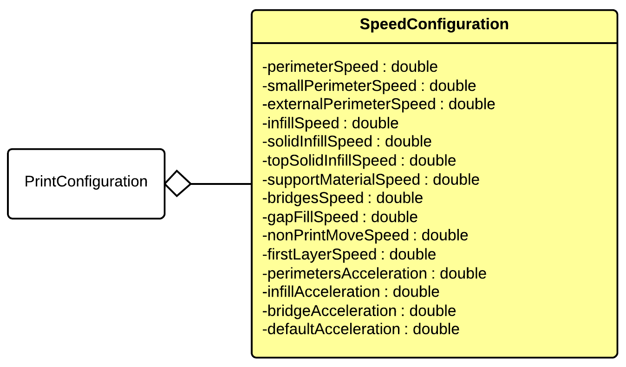
Speed Configuration Object
Name | Data Type | Description | Units | Boundaries
perimetersSpeed | double | Speed for perimeters | mm/s | Greater than 0.
smallPerimetersSpeed | double | Speed for small perimeters | mm/s | Greater than 0.
externalPerimetersSpeed | double | Speed for external perimeters | mm/s | Greater than 0.
infillSpeed | double | Speed for infill | mm/s | Greater than 0.
solidInfillSpeed | double | Speed for solid infill | mm/s | Greater than 0.
topSolidInfillSpeed | double | Speed for top solid infill | mm/s | Greater than 0.
supportMaterialSpeed | double | Speed for support material | mm/s | Greater than 0.
bridgesSpeed | double | Speed for bridges | mm/s | Greater than 0.
gapFillSpeed | double | Speed for gap fill | mm/s | Greater than 0.
nonPrintMovesSpeed | double | Speed for non prdouble movements | mm/s | Greater than 0.
firstLayerSpeed | double | Speed for the first layer | mm/s | Greater than 0.
perimetersAcceleration | double | Acceleration for perimeters | mm/s² | Greater than or equal to 0.
infillAcceleration | double | Acceleration for infill | mm/s² | Greater than or equal to 0.
bridgeAcceleration | double | Acceleration for bridges | mm/s² | Greater than or equal to 0.
defaultAcceleration | double | Default Acceleration | mm/s² | Greater than or equal to 0.

Slide 16
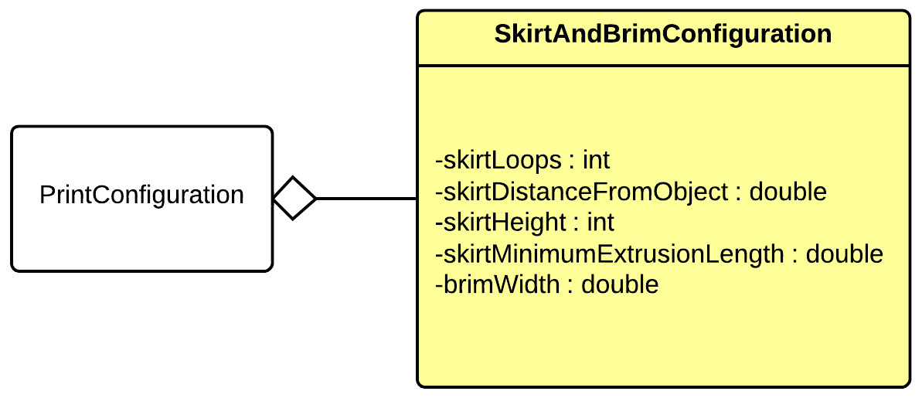
Skirt & Brim Configuration Object
Name | Data Type | Description | Units | Boundaries
skirtLoops | int | The number loops of skirt to extrude (0 will extrude no skirt). | Loops | Greater than or equal to 0.
skirtDistanceFromObject | double | The distance from the object the skirt will be extruded at in mm >= 0. Setting this to 0 will essentially turn the skirt into brim. | mm | Greater than or equal to 0.
skirtHeight | int | The height of the skirt in layers >= 1. | Layers | Greater than or equal to 1.
skirtMinimumExtrusionLength | double | The minimum extrusion length of the skirt in mm >= 0. | mm | Greater than or equal to 0.
brimWidth | double | The width of the brim in mm (0 will extrude no brim). | mm | Greater than or equal to 0.

Slide 17
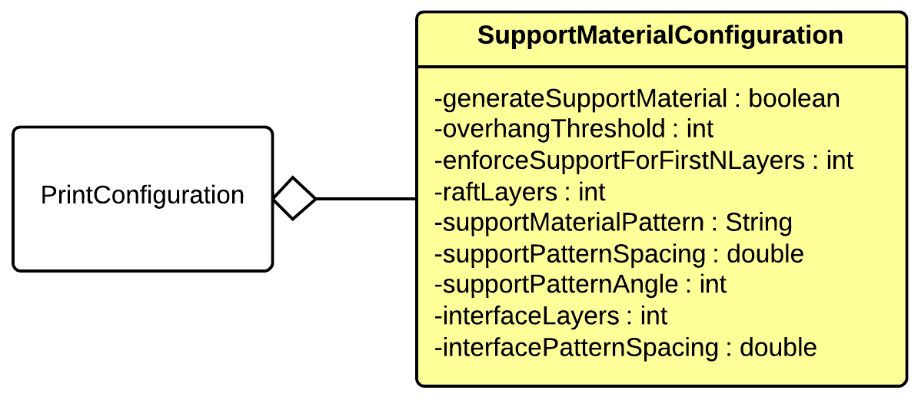
Support Material Configuration Object
Name | Data Type | Description | Units | Boundaries
generateSupportMaterial | boolean | When set to true, G-code for support material will be generated. | N/A | True or false
overhangThreshold | int | The overhang threshold in degrees. Support material will not be for overhangs whose slope angle is above this threshold. | degrees | 0 – 180
enforceSupportForFirstNLayers | int | Forces support material on the first n layers. | Layers | Greater than or equal to 0.
raftLayers | int | Number of raft layers to print below the object. | Layers | Greater than or equal to 0.
supportMaterialPattern | String | Pattern used to generate support material. | N/A | Within set of available infill patterns.
supportPatternSpacing | double | The spacing in mm between support lines. | mm | Greater than or equal to 0.
supportPatternAngle | int | The angle the support pattern is extruded at (between 0 and 359). | degrees | 0 – 359
interfaceLayers | int | The number of interface layers to print between the raft and object. | Layers | Greater than or equal to 0.
interfacePatternSpacing | double | The spacing in mm between support lines. | mm | Greater than or equal to 0.

Slide 18
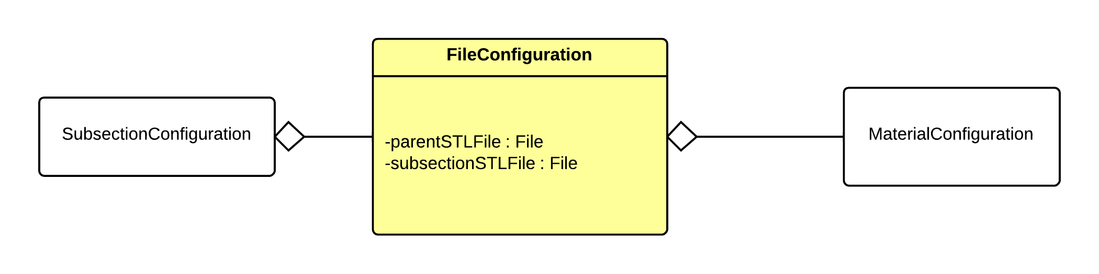
File Configuration Object
Name | Data Type | Description | Units | Boundaries
parentSTLFile | File | The reference to the parent STL that will be subsectioned in the preprocessing layer. | N/A | N/A
subsectionSTLFile | File | The reference to the STL file that represents the subsection of the parent STL file. This is set in the preprocessing layer. | N/A | N/A

Slide 19
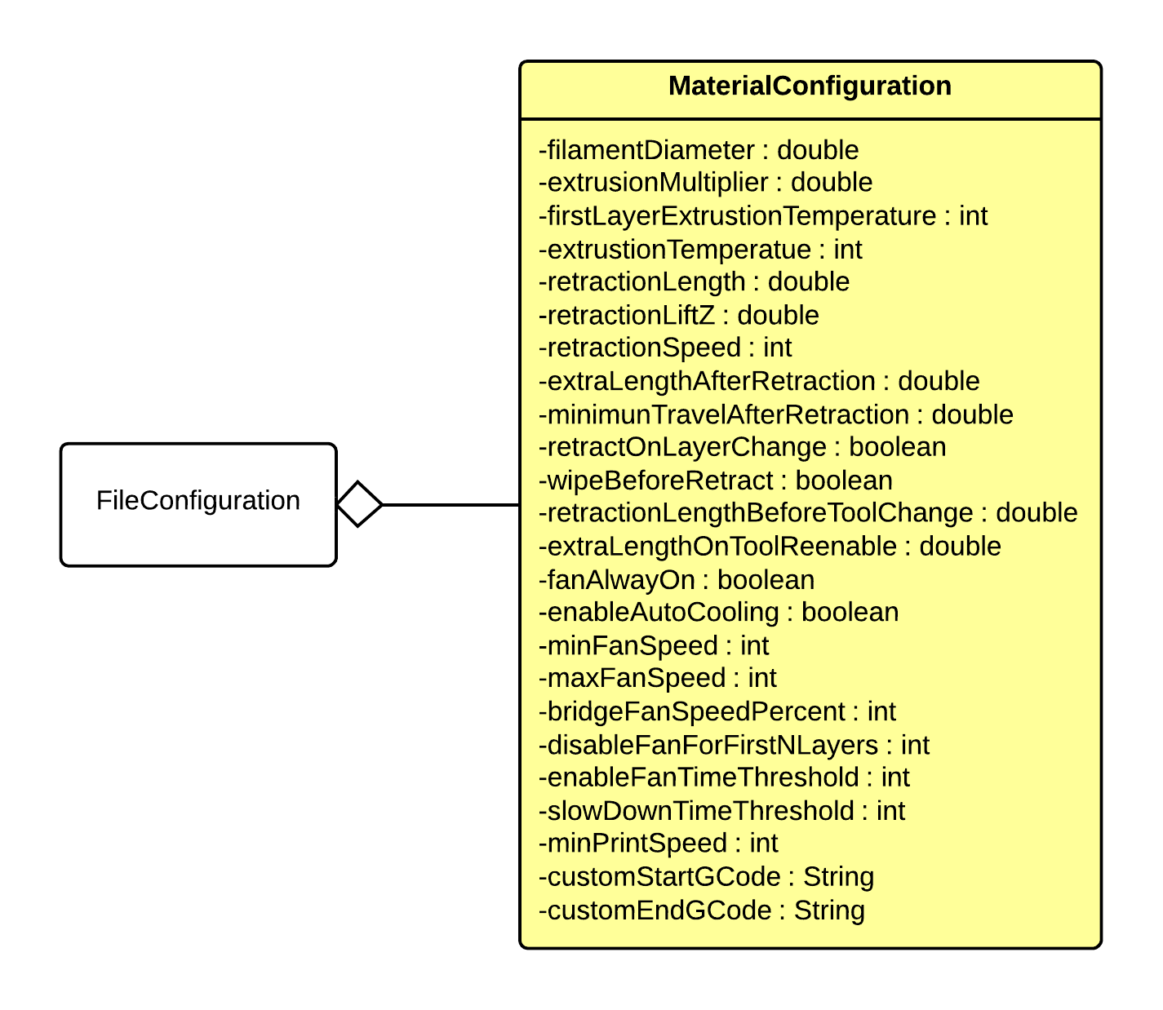
Material Configuration Object
Name | Data Type | Description | Units | Boundaries
filamentDiameter | double | Diameter in mm of the filament. | mm | Greater than 0.
extrusionMultiplier | double | Flow rate multiplier. This changes the flow rate proportionally. 0.9 will be 90% flow rate, while 1.1 will be 110% flow rate. | Ratio | Greater than 0.0.
firstLayerExtrusionTemperature | int | The temperature (in degrees C) the extruder needs to be to extrude the first layer of this material. | degrees C | Within extruder temperature range.
extrusionTemperature | int | The temperature (in degrees C) the extruder needs to be to extrude this material. | degrees C | Within extruder temperature range.
retractionLength | double | Length (in mm) to retract during retraction. 0 to disable retraction. | mm | Greater than or equal to 0.
retractionLiftZ | double | The (positive) z value to quickly lift the extruder by during a retraction. | mm | Greater than or equal to 0.
retractionSpeed | int | The speed (in mm/s) at which to retract the filament during retraction (extruder motor speed). | mm/s | Greater than or equal to 0.
extraLengthAfterRetraction | double | The extra length of filament to push out during the first extrude after a retraction. | mm | Greater than or equal to 0.
minimumTravelAfterRetraction | double | Retraction is not triggered when travel moves shorter than this distance. | mm | Greater than or equal to 0.
retractOnLayerChange | boolean | When set to true, retraction will be triggered on each layer change. | N/A | True or false
wipeBeforeRetract | boolean | When set to true, the nozzle will be moved while retracting to reduce blob. | N/A | True or false
retractionLengthBeforeToolChange | double | Length (in mm) to retract when the tool is disabled. | mm | Greater than or equal to 0.
extraLengthOnToolReenable | double | The extra length of filament to push out during the first extrude after the tool is re-enabled. | mm | Greater than or equal to 0.
fanAlwaysOn | boolean | When set to true, fan will always run at at least minimum speed. | N/A | True or false
enableAutoCooling | boolean | When set to true, fan speed will automatically be set based on printing time. | N/A | True or false
minFanSpeed | int | The minimum fan speed in PWM. | PWM | 0 – maxFanSpeed
maxFanSpeed | int | The maximum fan speed in PWM. | PWM | minFanSpeed – 100
bridgeFanSpeedPercent | int | The percentage of default fan speed used for bridges expressed as an int (100 = 100%) | % | 0 – 100
disableFanForFirstNLayers | int | The number of first layers to disable the fan for. | Layers | Greater than or equal to 0.
enableFanTimeThreshold | int | If the print time of a layer is below this threshold (in seconds), the fan will be activated. | Seconds | Greater than or equal to 0.
slowDownTimeTreshold | int | If the print time of a layer is below this threshold (in seconds), the move speed will be slowed to attempt to get the layer print time up to this threshold. | Seconds | Greater than or equal to 0.
minPrintSpeed | int | The move speed will not be scaled down below this speed. | mm/s | Greater than 0.
customStartGCode | String | The custom G-Code to run when the material starts printing. | N/A | G-Codes that are understood by the printer.
customEndGCode | String | The custom G-Code to run when the material stops printing. | N/A | G-Codes that are understood by the printer.

Slide 20
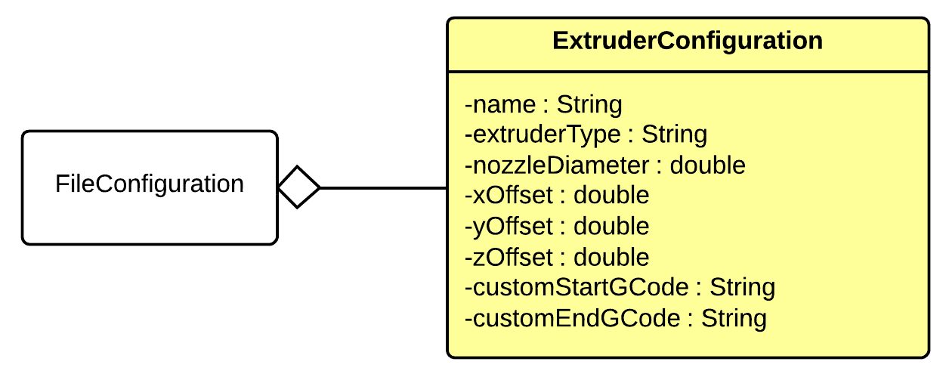
Material Configuration Object
Name | Data Type | Description | Units | Boundaries
extruderType | String | The type of extruder. | N/A | Within the set of available extruder types.
nozzleDiameter | double | The diameter of the nozzle in mm. | mm | Greater than or equal to 0.
xOffset | double | The x offset in respect to the position on the printer. | mm | Greater than or equal to 0.
yOffset | double | The y offset in respect to the position on the printer. | mm | Greater than or equal to 0.
zOffset | double | The z offset in respect to the position on the printer. | mm | Greater than or equal to 0.
customStartGCode | String | The custom G-Code to run when the extruder is activated for extrusion. | N/A | G-Codes that are understood by the printer.
customEndGCode | String | The custom G-Code to run when the extruder is deactivated after extrusion. | N/A | G-Codes that are understood by the printer.

Slide 21
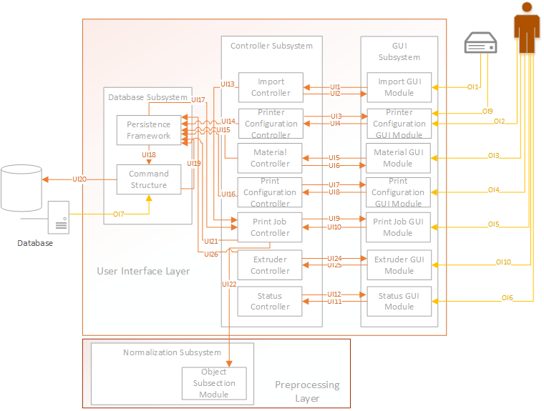
User Interface Layer

Slide 22
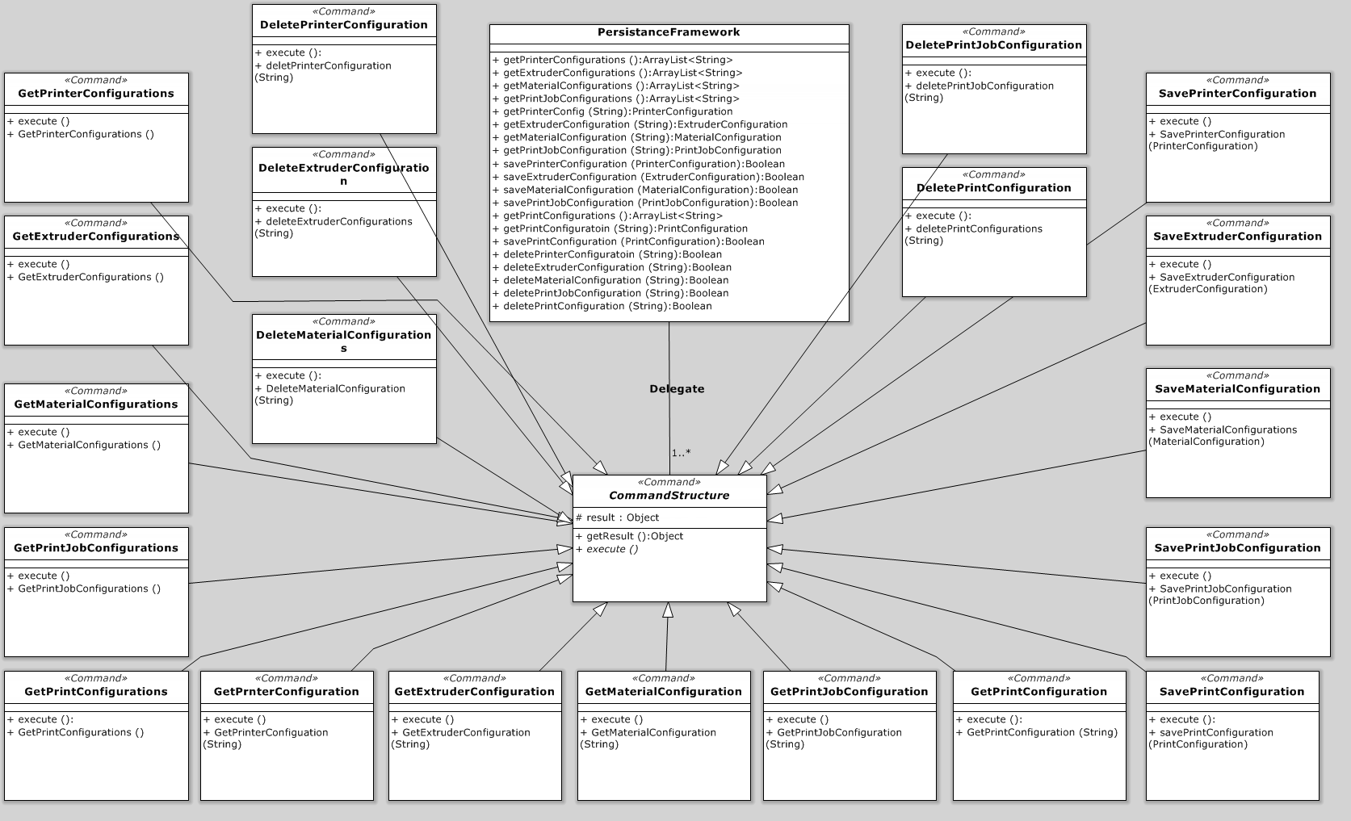
Database Subsystem

Slide 23
Persistence Framework Module
Interfaces
Interface | Information Required | Information Returned
getPrinterConfigurations | None | ArrayList<String> of names
getExtruderConfigurations | None | ArrayList<String> of names
getMaterialConfigurations | None | ArrayList<String> of names
getPrintJobConfigurations | None | ArrayList<String> of names
getPrintConfigurations | None | ArrayList<String> of names
getPrinterConfig | String name of the file | PrinterConfiguration Object
getExtruderConfig | String name of the file | ExtruderConfiguration Object
getMaterialConfig | String name of the file | MaterialConfiguration Object
getPrintJobConfiguration | String name of the file | PrintJobConfiguration Object
getPrintConfiguration | String name of the file | PrintConfiguration Object
savePrinterConfiguration | PrinterConfiguration Object | Boolean success state
saveExtruderConfiguration | ExtruderConfiguration Object | Boolean success state
saveMaterialConfiguration | MaterialConfiguration Object | Boolean success state
savePrintJobConfiguration | PrintJobConfiguration Object | Boolean success state
savePrintConfiguration | PrintConfiguration Object | Boolean success state
deletePrinterConfiguration | String name of the file | Boolean success state
deleteExtruderConfiguration | String name of the file | Boolean success state
deleteMaterialConfiguration | String name of the file | Boolean success state
deletePrintJobConfiguration | String name of the file | Boolean success state
deletePrintConfiguration | String name of the file | Boolean success state
Internal Data Descriptors
Data | Source
PrinterConfiguration Object | Printer Hardware Configuration Controller
ExtruderConfiguration Object | Extruder Controller
MaterialConfiguration Object | Material Controller
PrintJobConfiguration Object | Print Job Controller
PrintConfiguration Object | Print Controller

Slide 24
Command Structure Module
Interfaces
Interface | Information Required | Information Returned
getPrinterConfigurations | None | ArrayList<String> of names
getExtruderConfigurations | None | ArrayList<String> of names
getMaterialConfigurations | None | ArrayList<String> of names
getPrintJobConfigurations | None | ArrayList<String> of names
getPrintConfigurations | None | ArrayList<String> of names
getPrinterConfig | String name of the file | PrinterConfiguration Object
getExtruderConfig | String name of the file | ExtruderConfiguration Object
getMaterialConfig | String name of the file | MaterialConfiguration Object
getPrintJobConfiguration | String name of the file | PrintJobConfiguration Object
getPrintConfiguration | String name of the file | PrintConfiguration Object
savePrinterConfiguration | PrinterConfiguration Object | Boolean success state
saveExtruderConfiguration | ExtruderConfiguration Object | Boolean success state
saveMaterialConfiguration | MaterialConfiguration Object | Boolean success state
savePrintJobConfiguration | PrintJobConfiguration Object | Boolean success state
savePrintConfiguration | PrintConfiguration Object | Boolean success state
deletePrinterConfiguration | String name of the file | Boolean success state
deleteExtruderConfiguration | String name of the file | Boolean success state
deleteMaterialConfiguration | String name of the file | Boolean success state
deletePrintJobConfiguration | String name of the file | Boolean success state
deletePrintConfiguration | String name of the file | Boolean success state
Internal Data Descriptors
Data | Source
PrinterConfiguration Object | Persistence Framework
ExtruderConfiguration Object | Persistence Framework
MaterialConfiguration Object | Persistence Framework
PrintJobConfiguration Object | Persistence Framework
PrintConfiguration Object | Persistence Framework
External Data Descriptors
Data | Source
ArrayList<String> of file name | Storage Device (handled by OS)
XML files | Storage Device (handled by OS)

Slide 25
Import GUI Module
Interfaces
Interface | Information Required | Information Returned
importButton | Button Press and string file name | Message to user of success or failure
deleteButton | Button Press and string file name | Message to user of success or failure
“..generates the Import menu display that the user interacts with. The menu will provide options on screen such as import and delete.”
External Data Dependencies
Data | Source
User Input | User
STL File | Storage Device (handled by OS)
Internal Data Descriptors
none

Slide 26
Import Controller
Interfaces
Interface | Information Required | Information Returned
importSTL | The file name of the STL file | Boolean success state
delete | The file name of the STL file | Boolean success state
“.. carries out the functions of importing or removing STL files from the system when called by the Import GUI Module.”
External Data Dependencies
Data | Source
STL File | Storage Device (handled by OS)
Internal Data Descriptors
Data | Source
String File Name | Import GUI Module

Slide 27
Material Configuration GUI Module
Interfaces
Interface | Information Required | Information Returned
newButton | Button Press and string of file name | Display update
saveButton | Button Press and string name of material and data to populate the MaterialConfiguration object | Message to user of success or failure
deleteButton | Button Press and string of file name | Message to user of success or failure
“..a menu screen where the user can insert the descriptors for new material that is not present in the database.”
External Data Dependencies
Internal Data Descriptors
Data | Source
User Input | User
none

Slide 28
Material Configuration Controller
Interfaces
Interface | Information Required | Information Returned
saveMaterialConfiguration | MaterialConfiguration Object and string file name | Boolean success state
loadMaterialConfiguration | String name of file | MaterialConfiguration Object
deleteMaterialConfiguration | String name of file | Boolean success state
loadAvailableMaterials | None | ArrayList<String> of file names
“.. carries out the functions related to storing and managing material configuration.”
Internal Data Descriptors
Data | Source
Material Data (string array) | Material Configuration GUI
Material ArrayList<String> of names | PersistanceFramework
String file name to operate on | Material Configuration GUI
External Data Dependencies
none

Slide 29
Printer Configuration GUI Module
Interfaces
Interface | Information Required | Information Returned
newButton | Button Press and string of file name | Display update
saveButton | String name of file and data to populate the PrinterConfiguration Object | Message to user of success or failure
deleteButton | Button press and string of file name | Message to user of success or failure
“..a menu that lets the user enter information so that the system can understand the dimensions and capabilities of the 3D printer.”
External Data Dependencies
Data | Source
User Input | User
Internal Data Descriptors
none

Slide 30
Printer Configuration Controller
Interfaces
Interface | Information Required | Information Returned
savePrinterConfiguration | PrinterConfiguration Object and string file name | Boolean success state
loadPrinterConfiguration | String name of file | PrinterConfiguration Object
deletePrinterConfiguration | String name of file | Boolean success state
loadAvailablePrinters | None | ArrayList<String> of file names
getSerialPortEnumeration | None | ArrayList<String> of port discriptors
“.. carries out the functions that allow the user to store and retrieve information that the specify the capabilities of the 3D printer.”

Slide 31
Printer Configuration Controller
External Data Dependencies
Data | Source
STL File | Storage Device (handled by OS)
Internal Data Descriptors
Data | Source
Printer ArrayList<String> of names | PersistanceFramework
Printer Configuration String Array | Printer Configuration GUI
String File name to operate on | Printer Configuration GUI

Slide 32
Extruder Configuration GUI Module
Interfaces
Interface | Information Required | Information Returned
newButton | Button Press and string name of file | Display update
saveButton | Button Press and string name of file and data to populate the ExtruderConfiguration Object | Message to user of success or failure
deleteButton | Button Press and string name of file | Message to user of success or failure
“.. a menu that lets the user enter and save custom configurations for each extruder they own.”
Internal Data Descriptors
External Data Dependencies
none
Data | Source
User Input | User

Slide 33
Extruder Configuration Controller
Interfaces
Interface | Information Required | Information Returned
saveExtruderConfiguration | ExtruderConfiguration Object and string file name | Boolean success state
loadExtrudeConfiguration | String name of file | ExtruderConfiguration Object
deleteExtruderConfiguration | String name of file | Boolean success state
loadAvailableExtruders | None | ArrayList<String> of file names
“.. carries out the functions that store or retrieve an Extruder Configuration object. “
Internal Data Descriptors
External Data Dependencies
Data | Source
ExtruderConfig (String Array) | ExtruderConfigurationGui
String File name to operate on | ExtruderConfigurationGui
Print ArrayList<String> of names | PersistanceFramework
none

Slide 34
Print Configuration GUI Module
Interfaces
Interface | Information Required | Information Returned
newButton | Button Press and string name of file | Display update
saveButton | Button Press and string name of file and data to populate the PrintConfiguration Object | Message to user of success or failure
deleteButton | Button Press and string name of file | Message to user of success or failure
“.. a menu that lets the user enter and save a set information that will let the system understand how the user wants a subsection of the print job to run.”
Internal Data Descriptors
External Data Dependencies
Data | Source
User Input | User
none

Slide 35
Print Configuration Controller
Interfaces
Interface | Information Required | Information Returned
savePrintConfiguration | PrintConfiguration Object and string file name | Boolean success state
loadPrintConfiguration | String name of file | PrintConfiguration Object
deletePrintConfiguration | String name of file | Boolean success state
loadAvailablePrints | None | ArrayList<String> of file names
“.. carries out the functions that allow the user store or retrieve a Print Configuration object.”
Internal Data Descriptors
External Data Dependencies
Data | Source
PrintConfig (String Array) | PrintConfigurationGui
String File name to operate on | PrintConfigurationGui
Print ArrayList<String> of names | PersistanceFramework
none

Slide 36
Status GUI Module
Interfaces
Interface | Information Required | Information Returned
pauseResumeButton | Button Press | Display Update
cancelButton | Button Press | Message to user of success or failure
“.. a window that displays the current status of the print job while the print job is ongoing.”
External Data Dependencies
Data | Source
User Input | User
Internal Data Descriptors
none

Slide 37
Status Controller
Interfaces
Interface | Information Required | Information Returned
updateStatus | printerStatus object | Data value updates
pauseResumeJob | CurrentStateFlag | Boolean success state
cancelPrintJob | None | Boolean success state
“.. listens for feedback from the Communication Layer and passes the values it receives to the Status GUI module …”
External Data Dependencies
none
Internal Data Descriptors
Data | Source
printerStatus object | StateControllerModule
Button Press event object | StatusGUI

Slide 38
Print Job GUI Module
Interfaces
Interface | Information Required | Information Returned
loadPrintJobConfiguration | Button Press and string name of file | Display update
newSubsection | Button Press | Display update
savePrintJobConfiguration | Button Press and string name of file and data to populate the PrintJobConfiguration object | Message to user of success or failure
“.. a menu that allows the user to set up a print job by dividing the print job into subsections.”
Internal Data Descriptors
External Data Dependencies
none
Data | Source
User Input | User

Slide 39
Print Job Controller
Interfaces
Interface | Information Required | Information Returned
loadAvailablePrintJobs | None | ArrayList<String> of file names
loadAvailablePrinters | None | ArrayList<String> of file names
loadAvailablePrints | None | ArrayList<String> of file names
loadAvailableExtruders | None | ArrayList<String> of file names
loadAvailableMaterials | None | ArrayList<String> of file names
loadPrintJobConfiguration | String file name | PrintJobConfiguration object
savePrintJobConfiguration | String file name and data objects to populate the PrintJobConfiguration object | Boolean success state
startPrint | PrintJobConfiguration Object | Opened StatusGUI
“.. receives the information gathered by the Print Job GUI Module…”
[and] “.. then compiles this information into an object that the other layer’s modules will reference…”

Slide 40
Print Job Controller
External Data Dependency
none
Internal Data Descriptors
Data | Source
PrintJob (Object Array) | PrintJobGui
String File name to operate on | PrintJobGui
Print ArrayList<String> of names | PersistanceFramework
PrintConfiguration Objects | PersistanceFramework
PrinterConfiguration Objects | PersistanceFramework
MaterialConfiguration Objects | PersistanceFramework
ExtruderConfiguration Objects | PersistanceFramework

Slide 41
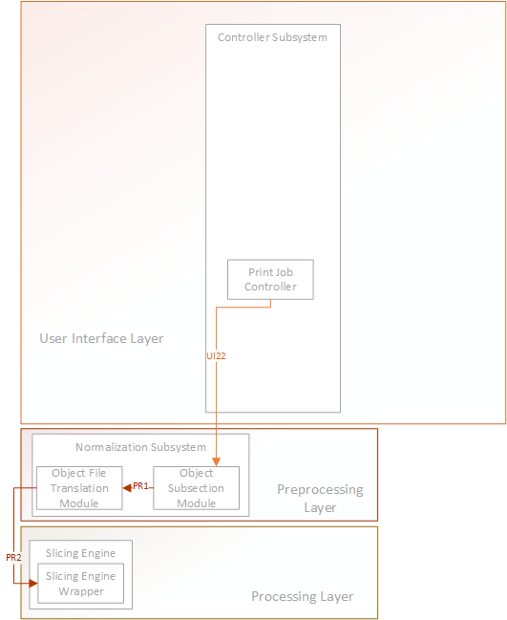
Preprocessing Layer

Slide 42
Subsection Module
Interfaces
Interface | Information Required | Information Returned
createSubsections | Print Job Configuration Object | Modified Print Job Configuration Object
External Data Dependencies
Data | Source
Subsectioned STL files | OpenSCAD Executable
Internal Data Descriptors
Data | Source
PrintJobConfiguration object | PrintJobController

Slide 43
Subsection Module (cont.)
Data Required from Print Job Configuration
Parent STL Files in each subsection
Bottom Z for each subsection
Top Z for each subsection
Data Modified in Print Job Configuration
Subsection STL Files for each subsection

Slide 44
Subsection Module (cont.)
Testing
Given a Print Job Configuration Object containing the bottom z, top z, and Parent STL files for each subsection, the Subsection Module will create new Subsection STL files (sub-sectioned by z = bottom z and z = top z planes) for each Parent STL file and store the reference to the created Subsection STL files back into the Print Job Configuration Object.

Slide 45
File Translation Module
Interfaces
Interface | Information Required | Information Returned
translateFiles | Print Job Configuration Object | Modified Print Job Configuration Object
External Data Depenedencies
None
Internal Data Descriptors
Data | Source
PrintJobConfiguration object | PrintJobController

Slide 46
File Translation Module (cont.)
Data Required from Print Job Configuration
Subsection STL Files for each subsection
Materials of each STL File for each subsection
Data Modified in Print Job Configuration
AMF File for each subsection

Slide 47
File Translation Module (cont.)
Testing
Given the Print Job Configuration Object containing the Subsection STL files for each subsection as well as the materials for each STL file, the File Translation Module will translate these files into a correct AMF File for each subsection.

Slide 48
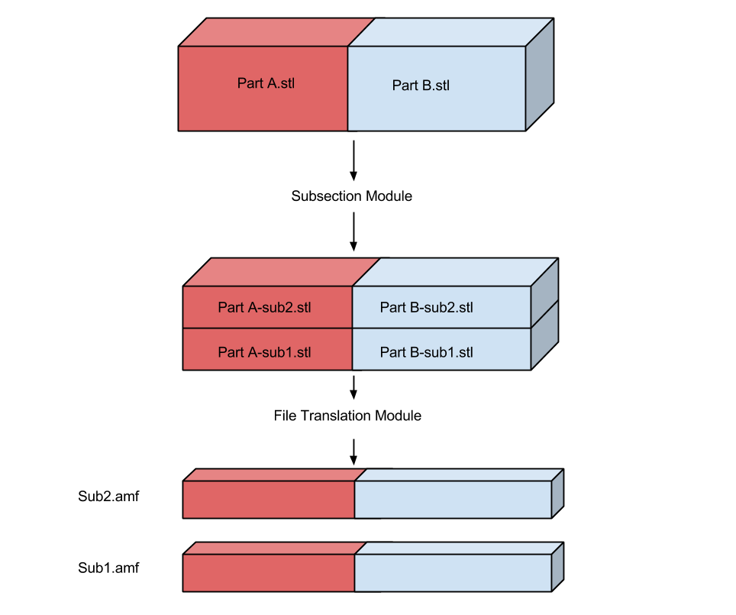
Object Lifecycle

Slide 49
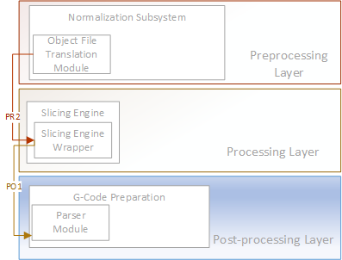
Processing Layer

Slide 50
Slicing Engine Wrapper Module
Interfaces
Interface | Information Required | Information Returned
GenerateGCode | Print Job Configuration Object | Modified Print Job Configuration Object
External Data Dependencies
Data | Source
G-Code files | Slic3r Slicing Engine
Internal Data Descriptors
Data | Source
PrintJobConfiguration object | PrintJobController

Slide 51
Slicing Engine Wrapper (cont.)
Required Data from Print Job Configuration
For each subsection, all data elements from the following classes:
InfillConfiguration
LayerAndPerimeterConfiguration
SpeedConfiguration
SkirtAndBrimConfiguration
SupportMaterialConfiguration
For each file in each subsection, all data elements from the following classes:
MaterialConfiguration
ExtruderConfiguration
The following data elements from the PrinterConfiguration class:
bedX
bedY
printCenterX
printCenterY
zOffset
gCodeFlavor
useRelativeEDistances
vibrationLimit
Data Modified in Print Job Configuration
G-Code files for each subsection

Slide 52
Slicing Engine Wrapper Module (cont.)
Testing
Given a Print Job Configuration Object with all required data elements the Slicing Engine Wrapper will run the Slic3r slicing engine to produce a G-Code file for each subsection and place a reference to each G-Code file into the Print Job Configuration Object.

Slide 53
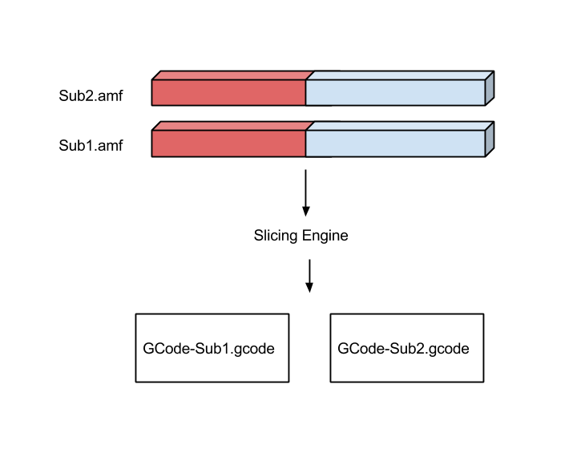
Object Lifecycle

Slide 54
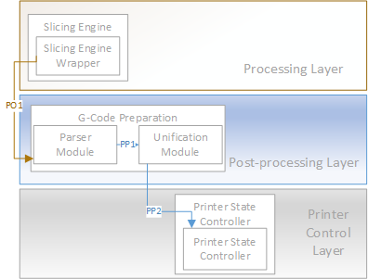
Post Processing Layer

Slide 55
Parser Module
Interfaces
Interface | Information Required | Information Returned
parseAndModifyGCode | Print Job Configuration Object | Modified Print Job Configuration Object
External Data Dependencies
None
Internal Data Descriptors
Data | Source
PrintJobConfiguration object | PrintJobController

Slide 56
Parser Module (cont.)
Required Data from Print Job Configuration
G-Code files for each subsection
Printer G-Code flavor
Custom print start/end G-Code
Data Modified in Print Job Configuration
G-Code files for each subsection

Slide 57
Parser Module (cont.)
Testing
Given a Print Job Configuration Object with all required data elements the Parser Module will modify or delete any unacceptable G-Codes found any G-Code files.

Slide 58
Unification Module
Interfaces
Interface | Information Required | Information Returned
unifyGCode | Print Job Configuration Object | Modified Print Job Configuration Object
External Data Dependencies
None
Internal Data Descriptors
Data | Source
PrintJobConfiguration object | PrintJobController

Slide 59
Unification Module (cont.)
Required Data from Print Job Configuration
G-Code files for each subsection
Data Modified in Print Job Configuration
Finalized Print Job G-Code file

Slide 60
Unification Module (cont.)
Testing
Given a Print Job Configuration Object with all required data elements the Unification Module will concatenate all Subsection G-Code files into a single Finalized G-Code file and place a reference to the finalized G-Code file into the Print Job Configuration Object.

Slide 61
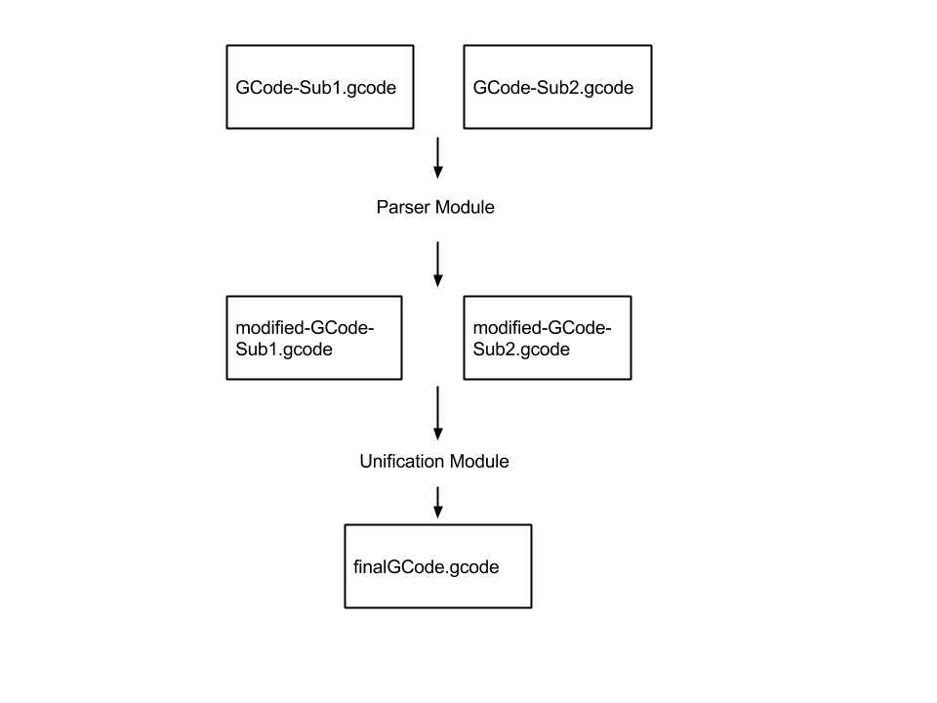
Object Lifecycle

Slide 62
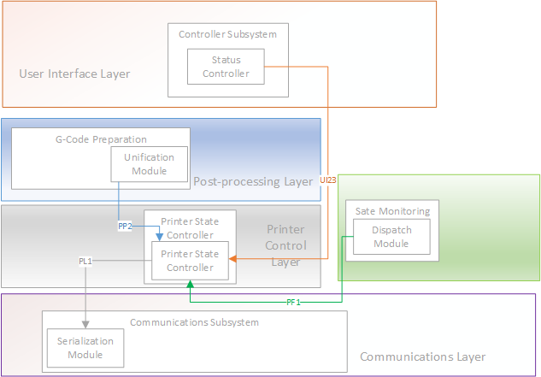
Printer Control Layer

Slide 63
Printer State Control Module
Interfaces
“..will buffer the G-Code data such that it can be presented to the communications layer to be transferred to the printer hardware..”
Interface | Information Required | Information Returned
runPrintJob | Print Job Configuration Object | None
pauseResumePrintJob | Change flag status | Boolean success state
cancelPrintJob | None | Boolean success state
updateStatus | PrinterStatus Object | None
“..the printer state control module will insert safety G-Codes into the G-Code buffer based on input from the printer feedback layer”
External Data Dependencies
None.
Internal Data Descriptors
Data | Source
PrintJobConfiguration Object | Print Job Controller
PrinterStatus Object | Dispatch Module

Slide 64
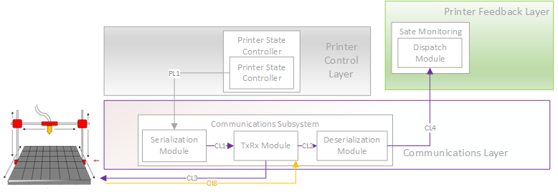
Communications Layer

Slide 65
RX/TX Module
“The Receive/Transmit module will first establish a connection to the printer firmware using the information passed via the PrintJobConfiguration object.”
“Will maintain a transmit and receive ring buffer locally for ingoing and outgoing messages. The module will coordinate copying of these buffers to and from the printer.”
Interfaces
Interface | Information Required | Information Returned
Transmit | Serialized Data | ACK details
Receive | Buffer | Serialized Data
InitializeConnection | PrintJobConfiguration Object | Boolean success rate
External Data Dependencies
Data | Source
Buffered Serial Data | Printer
Internal Data Descriptors
Data | Source
Serialized G-Code Buffer | Serialization Module
PrintJobConfiguration object | Print Job Controller Module

Slide 66
Serialization Module
“The serialization module will receive the G-Codes that carry out the print process and serialize them in preparation to be sent to the RX/TX module.
The module will also buffer the serialized G-Codes so that they can be sent to the printer.
If ACK is not enforced, then the buffer contains 5 serialized G-Codes. Otherwise it contains 1.
Interfaces
Interface | Information Required | Information Returned
serializeData | G-Code | None
External Data Dependencies
None.
Internal Data Descriptors
Data | Source
G-Code Object | Printer State Controller

Slide 67
Deserialization Module
“The Deserialization Module acts in the reverse way that the Serialization Module does. The Deserialization module will poll the RXTX Module until printer feedback data becomes available. It will then copy this data and Deserialize it back into a data structure that is readable. This data structure will be used by the Dispatch Module to populate the PrinterStatus object.
Interfaces
Interface | Information Required | Information Returned
deserializeData | Serialized data | ArrayList <Object>
External Data Dependencies
None.
Internal Data Descriptors
Data | Source
Printer Status Buffer | RXTX Module

Slide 68
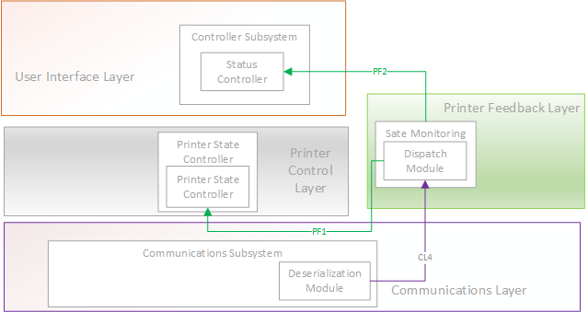
Printer Feedback Layer

Slide 69
Dispatch Module
“The dispatch module will poll the receive buffer in the Deserialization Module continually until printer feedback information is available. The information contained in this buffer will be used to populate the PrinterStatus Object.
The PrinterStatus Object makes the feedback data readable for the user interface and printer control layers.
Interfaces
Interface | Information Required | Information Returned
startPolling | PrinterStatus Object | PrinterStatus object updates
External Data Dependencies
None.
Internal Data Descriptors
Data | Source
PrinterStatus object | Deserialization Module

Slide 70
Requirements Traceability User Interface Layer
Number | Title | Interface Layer | Import GUI | Printer Configuration GUI | Material GUI | Print Configuration GUI | Print Job GUI | Status GUI | Extruder Configuration GUI | Import Controller | Printer Configuration Controller | Material Controller | Print Configuration Controller | Print Job Controller | Extruder Configuration Controller | Status Controller | Persistence Framework | Command Structure
3.1 | STL File Input | X | X |  |  |  |  |  |  | X
3.2 | Graphical User Interface (GUI) | X | X | X | X | X | X | X | X | X | X | X | X | X | X | X | X | X
3.3 | Generate Machine Instructions
3.4 | Issue Machine Instructions
3.5 | Monitor Temperature | X |  |  |  |  |  | X |  |  |  |  |  |  |  | X
3.6 | Monitor Position
3.7 | Adhere to Material Constraints | X |  |  | X | X | X |  | X |  | X | X | X
3.8 | Identify Materials | X
3.9 | Identify Shapes
3.1 | Determine Shape of Material Support Structure
3.11 | Create Printing Path
3.12 | Database Interface | X |  |  |  |  |  |  |  |  |  |  |  |  |  |  | X | X
3.13 | Load & Store Materials | X |  |  | X |  |  |  |  |  |  | X |  |  |  |  | X | X
3.14 | Slice Geometry into Thickness Levels
3.15 | Monitor Flow Sensors
3.17 | Allow for UV Head Polymerization | X |  |  | X |  |  |  |  |  |  | X
8.1 | Material Database | X |  |  |  |  |  |  |  |  |  |  |  |  |  |  | X | X
8.2 | Abstract Hardware Interface | X |  | X |  |  | X |  |  |  | X |  |  | X
8.3 | Modular and Scalable Design | X | X | X | X | X | X | X | X | X | X | X | X | X | X | X | X | X

Slide 71
Requirements Traceability Processing Layers
Number | Title | Preprocessing Layer Object Subsection | Preprocessing Layer Object File Translation | Processing Layer Slicing Engine Wrapper | Post Processing Layer Parser | Post Processing Layer Unification
3.1 | STL File Input
3.2 | Graphical User Interface (GUI)
3.3 | Generate Machine Instructions |  |  | X | X | X
3.4 | Issue Machine Instructions
3.5 | Monitor Temperature
3.6 | Monitor Position
3.7 | Adhere to Material Constraints |  |  | X | X | X
3.8 | Identify Materials | X | X | X | X | X
3.9 | Identify Shapes |  |  | X
3.1 | Determine Shape of Material Support Structure |  |  | X
3.11 | Create Printing Path |  |  | X | X | X
3.12 | Database Interface
3.13 | Load & Store Materials
3.14 | Slice Geometry into Thickness Levels |  |  | X
3.15 | Monitor Flow Sensors
3.17 | Allow for UV Head Polymerization |  |  | X | X | X
8.1 | Material Database
8.2 | Abstract Hardware Interface
8.3 | Modular and Scalable Design | X | X | X | X | X

Slide 72
Requirements Traceability Printer State, Communications and Printer Feedback Layers
Number | Title | Printer Control Layer Printer State Controller | Communications Serialization | Communications RxTx | Communications Deserialization | Printer | Printer Feedback Layer Dispatch
3.1 | STL File Input
3.2 | Graphical User Interface (GUI)
3.3 | Generate Machine Instructions | X
3.4 | Issue Machine Instructions |  | X | X | X
3.5 | Monitor Temperature | X | X | X | X | X | X
3.6 | Monitor Position | X | X | X | X | X | X
3.7 | Adhere to Material Constraints | X | X | X | X | X | X
3.8 | Identify Materials
3.9 | Identify Shapes
3.1 | Determine Shape of Material Support Structure
3.11 | Create Printing Path
3.12 | Database Interface
3.13 | Load & Store Materials
3.14 | Slice Geometry into Thickness Levels
3.15 | Monitor Flow Sensors | X |  | X | X | X | X
3.17 | Allow for UV Head Polymerization | X |  |  |  | X
8.1 | Material Database
8.2 | Abstract Hardware Interface | X |  |  |  | X | X
8.3 | Modular and Scalable Design | X | X | X | X | X | X

Slide 73
Acceptance Plan
Package and Installation
Thumb Drive Installation
Acceptance Criteria
STL File Input
Graphical User Interface
Generate Machine Instructions
Issue Machine Instructions
Monitor Temperature
Monitor Position
Adhere to Material Constraints
Identify Materials
Identify Shapes
Determine Shape of Material Support Structure
Create Printing Path
Database Interface
Load and Store Materials
Slice Geometry into Thickness Levels
Monitor Flow Sensors
Allow for UV Head Polymerization
Material Database
Abstract Hardware Interface
Modular and Scalable Design

